Slide 1
Matrix Chain Multiplication
Problem
  Find an optimal parenthesization of matrix chain multiplication
Matrix chain multiplication
  M = M₁M₂…M_{n}
Parenthesization
  A product of matrices is fully parenthesized if it is either a single matrix or the product of two fully parenthesized matrix products, surrounded by parentheses

Slide 2
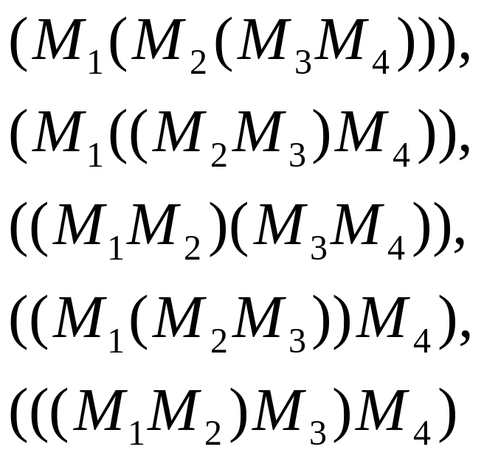
Example
The product of M₁M₂M₃M₄ can be parenthesized in five distinct ways

Slide 3
Cost of matrix multiplication
The cost of matrix multiplication is dominated by scalar multiplications.
The cost of multiplying a pq matrix with a qr matrix is pqr
for (i=0; i<p; i++)
for (j=0; j<r; j++) {
C[i][j] = 0;
for (k=0; k<q; k++)
C[i][j] += A[i][k]*B[k][j];
}

Slide 4
Why parenthesization is important
Consider a chain <A1, A2, A3> and the dimensions of the matrices are 10100, 1005, and 550.
  Cost for ((A1A2)A3) is 10*100*5+10*5*50 = 7,500
  Cost for (A1(A2A3)) is 100*5*50+10*100*50=75,000
  One is 10 times faster than the other!

Slide 5
The Matrix Chain Multiplication Problem
Given a chain of <M₁, M₂, …, M_{n}> of matrices, where for i = 1, 2, …, n, matrix M_{i} has dimension p_{i-1} p_{i}, fully parenthesize the product in a way that M₁M₂…M_{n} minimizes the number of scalar multiplications

Slide 6
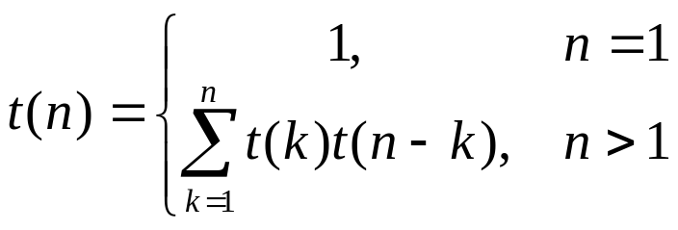
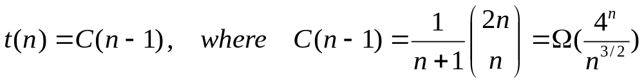
Counting the number of parenthesizations
We can split a sequence of n matrices between k_{th} and (k+1)_{st} matrices. We obtain the recurrence
The solution is the sequence of Catalan numbers

Slide 7
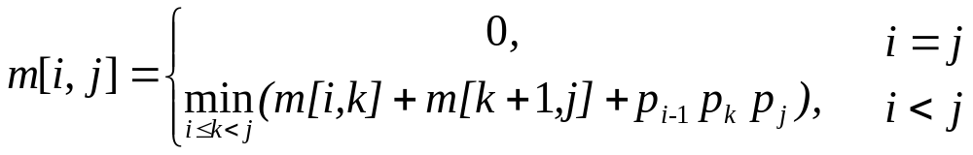
A recursive equation (optimal substructure)
Let m[i,j] be the minimum number of scalar multiplications needed to compute M_{i..j}
  The cost for is M_{1..n} is m[1,n]
Assume that the optimal parenthesization splits the product M_{i}M_{i+1}…M_{j} between M_{k} and M_{k+1}
  Based on the principle of the optimality
  m[i,j] = m[i,k]+m[k+1,j]+p_{i-1} p_{k} p_{j}
  We obtain the following recurrence

Slide 8
Dynamic programming
We start from each single matrix
We then calculate the minimum number of multiplications for length l sequence for l = 2,…n
  The final solution is that for length n
M1 M2 M3 M4 M5 l=1
M1 M2 M3 M4 M5 l=4
M1 M2 M3 M4 M5 l=2
M1 M2 M3 M4 M5 l=5
M1 M2 M3 M4 M5 l=3

Slide 9
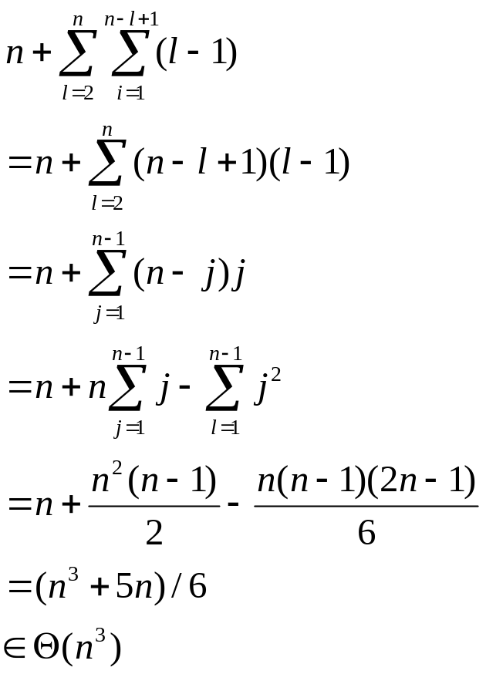
An implementation using dynamic programming
Cost:
matixChain()
{
for (i=1; i<=n; i++) // sequence of length 1
m[i][i]=0;
for (l=2; <=n; l++) // l is the length of the sequence
for (i=1; i<=n-l+1; i++) {
j = i+l-1;
m[i][j] = ;
for (k=i; k<=j-1; k++)
tmp = m[i,k]+m[k+1,j]+p[i-1]p[k]p[j]
if (tmp < m[i][j]) {
m[i][j] = tmp;
s[i][j] = k; // split point
}
}
}

Slide 10
Example
M1 | 135
M2 | 589
M3 | 893
M4 | 334
j
 | 1 | 2 | 3 | 4
1 | 0 | 5785 | 1530₁ | 2856₃
2 |  | 0 | 1335 | 1845₃
3 |  |  | 0 | 9078
4 |  |  |  | 0
i
m[1][3]=min(m[1][1]+m[2][3]+13*5*3, m[1][2]+m[3][3]+13*89*3)=min(1530,9256)=1530
m[2][4]=min(m[2][2]+m[3][4]+5*89*34, m[2][3]+m[4][4]+5*3*34)=min(24208,1845)=1845
min[1][4]=min(m[1][1]+m[2][4]+13*5*34, k=1
m[1][2]+m[2][4]+13*89*34, k=2
m[1][3]+m[4][4]+13*3*34) k=3
=min(4055, 54201, 2856) = 2856

Slide 11
Construct the optimal parenthesization
In our algorithm, the matrix s tracks the split point
  Can you use the matrix to construct the optimal parenthesization?
PrintOptimalParens(s, i, j)
{
if (i==j)
print (“M”_{i})
else {
print(“(“);
PrintOptimalParens(s, i, s[i][j]);
PrintOptimalParens(s, s[i][j]+1, j);
Print(“)”)
}
}

